Slide 1
VACCINATION SURVEY ANALYSIS
Name: MAUL SRI M
Date Submitted: 09/12/2024

Slide 2
INTRODUCTION
Conducted surveys through UNICEF and WHO.
Gather data on vaccination coverage.
Collects information on vaccine types.
Enhance vaccine distribution.

Slide 3
AIM
Analyze Vaccination Coverage
Monitor Vaccination Rates
Identify Coverage Gaps
Reduce Health Inequities

Slide 4
OBJECTIVES
Quality assessment checks for inconsistencies.
Track Vaccine Distribution Patterns.
Visualize vaccine coverage by geographic area.
Identify outliers across cohorts.

Slide 5
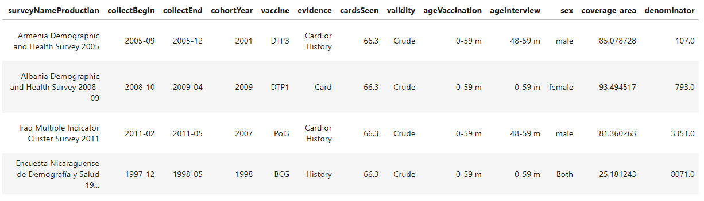
DATA PREVIEW

Slide 6
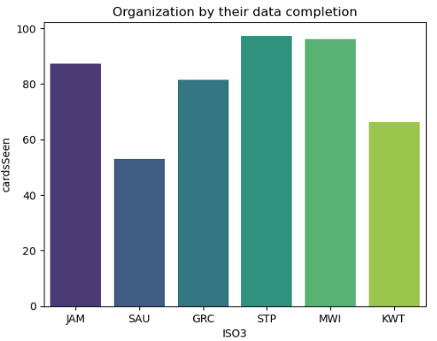
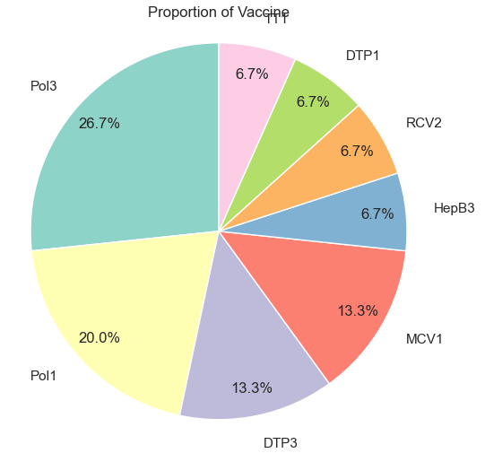
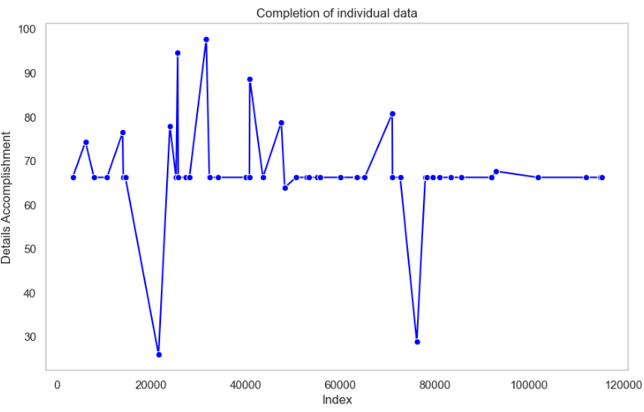
VISUALISATION

Slide 7
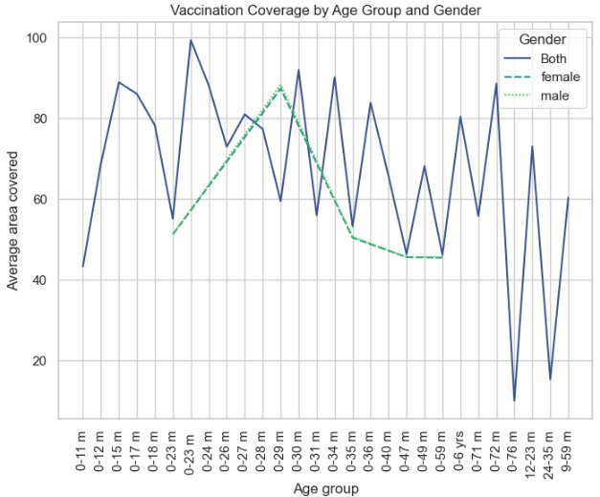
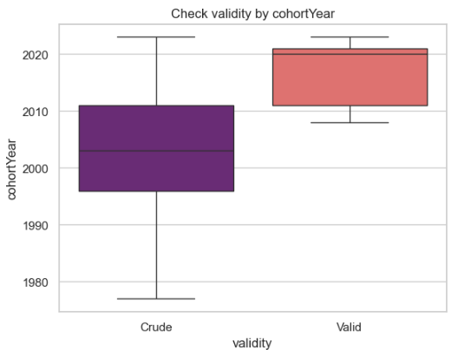
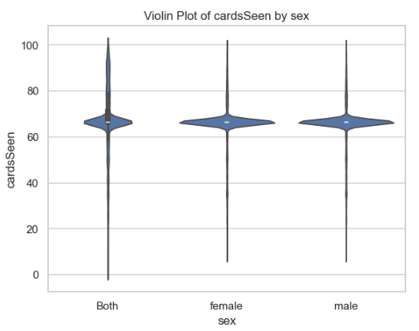
TRENDS AND OUTLIERS

Slide 8
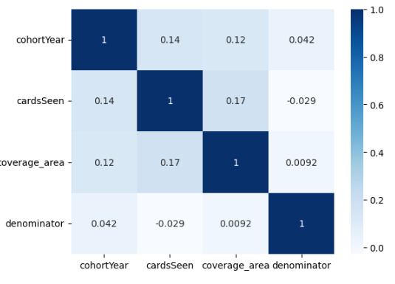
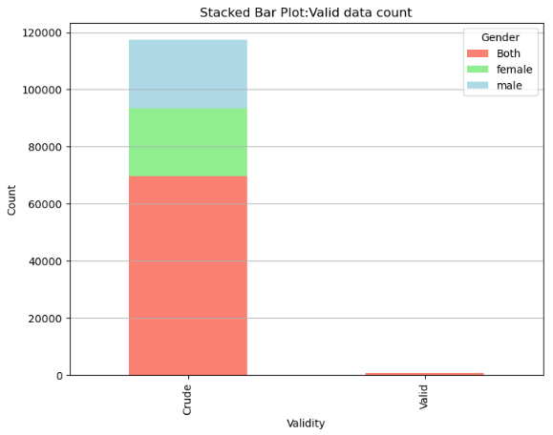
Data Patterns

Slide 9
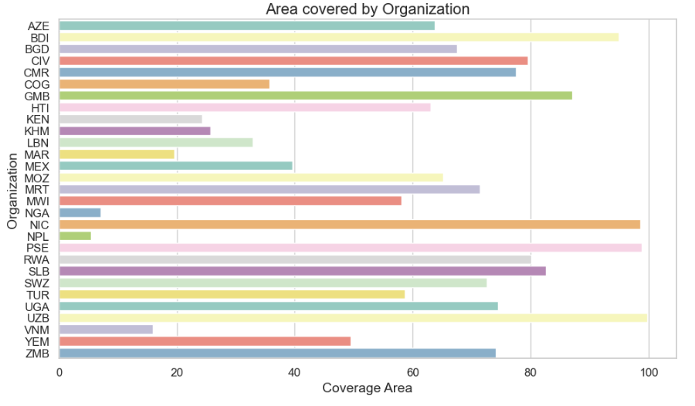
Coverage Zone

Slide 10
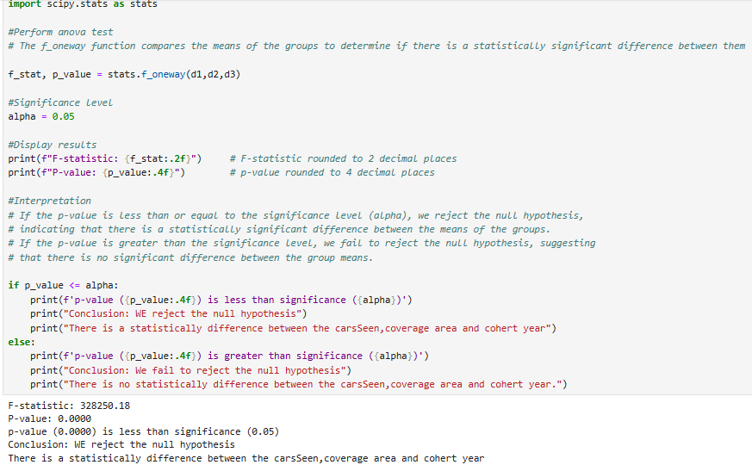
STATISTICAL ANALYSIS

Slide 11
CONCLUSION
Build public trust.
Shape future vaccination strategies .
Boost Community Engagement.
Ensure equal access.
Target underserved regions.

Slide 12
THANK YOU

